Slide 1

EE-371 : Control Systems
Lecture#31, 32
ROOT LOCUS TECHNIQUES (A Graphical Tool)
8.5 Refining the Sketch of Root Locus
Textbook: Chapter # 08 (5th edition)
Text Book: Control Systems Engineering by Norman S. Nise 5th Edition
Instructor: Ms Neelma Naz
Class: BEE 12 C/D
School of Electrical Engineering and Computer Science
Department of Electrical Engineering

Slide 2
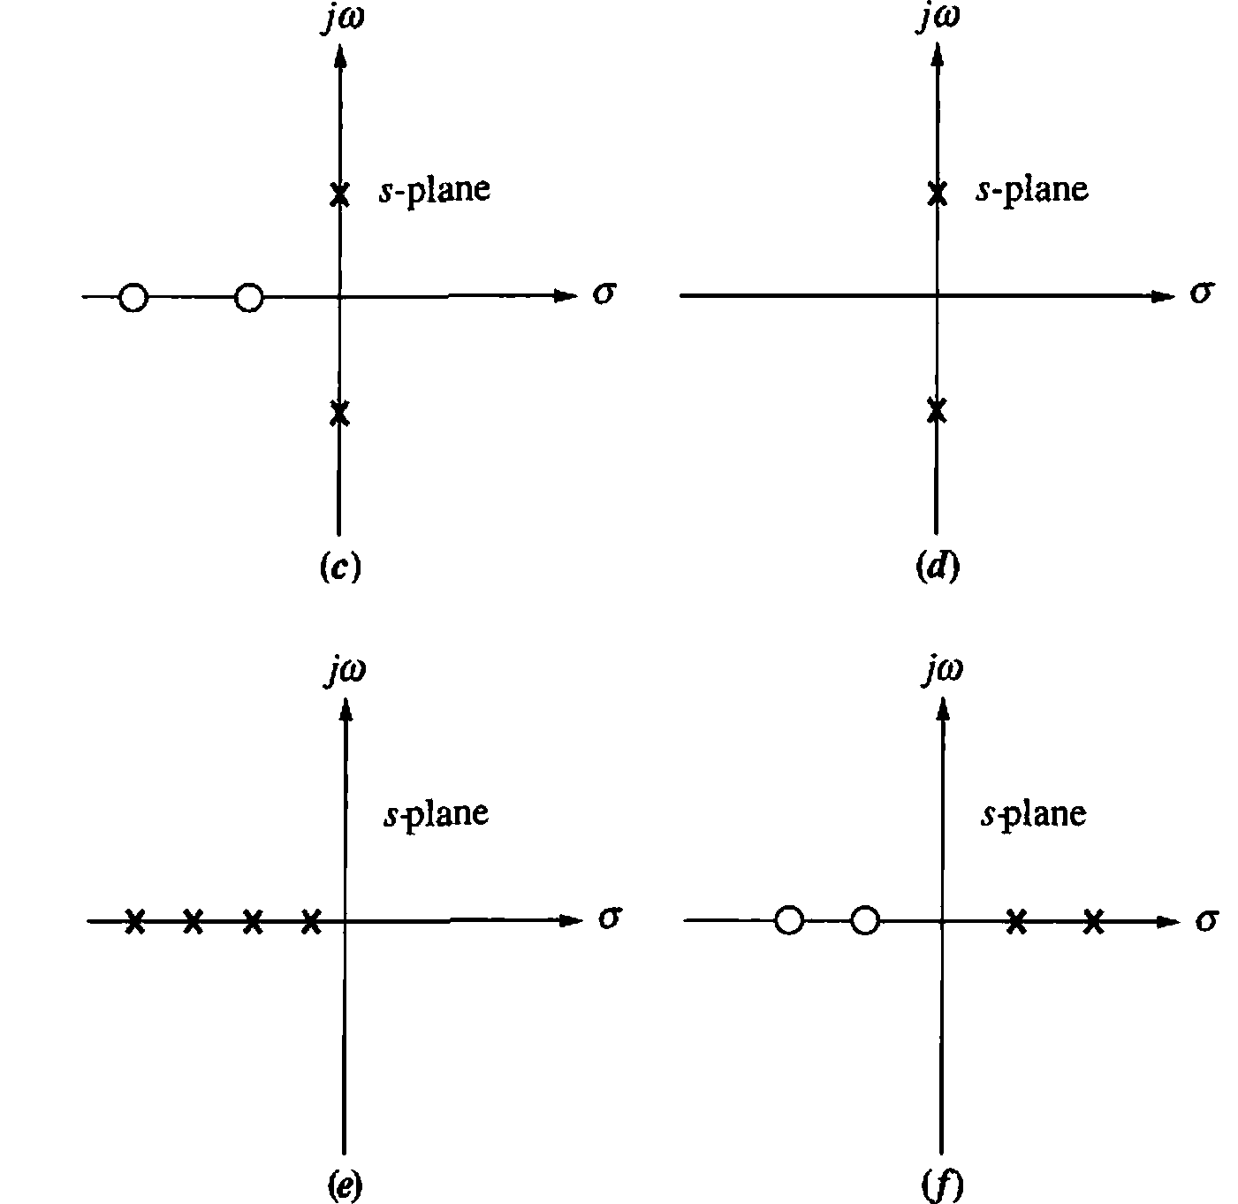
Activity
Sketch Root Locus

Slide 3
Refining the Sketch of Root Locus

Slide 4
Breakaway and Break-in points:
Points on the real axis where the root locus leaves or enters the real-axis
jω-axis Crossing:
Points where the root locus cross the jω-axis
Angles of departure and arrival:
The angles of departure from complex poles and angles of arrival at complex zeros

Slide 5
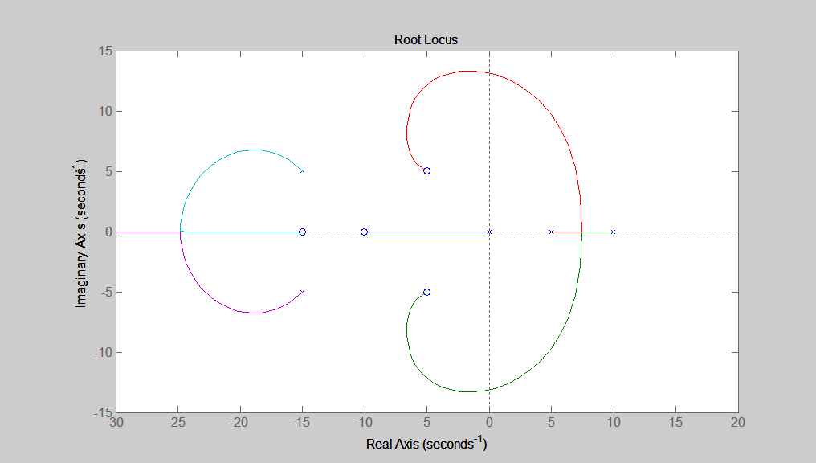
Angles of departure:
The angles of departure from complex poles
Breakaway points:
Points on the real axis where the root locus leaves the real-axis
Angles of arrival:
The angles of arrival at complex zeros
Break-in points:
Points on the real axis where the root locus enters the real-axis
jω-axis Crossing:
Points where the root locus cross the jω-axis

Slide 6
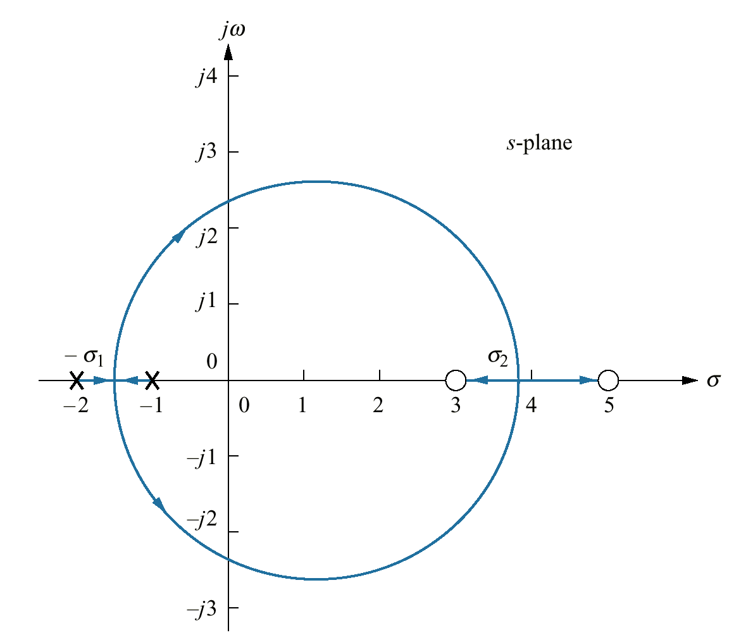
Breakaway and Break-in points:
Real- axis breakaway (-σ₁) and break-in points (σ₂)
The root locus is sketched using the first four rules:
(1) number of branches
(2) symmetry
(3) real-axis segments
(4) starting and ending points
The branches of the root locus form an angle of 180° /n with the real axis.
“n” is the number of closed-loop poles arriving at or departing from the single breakaway or break-in point on the real axis

Slide 7
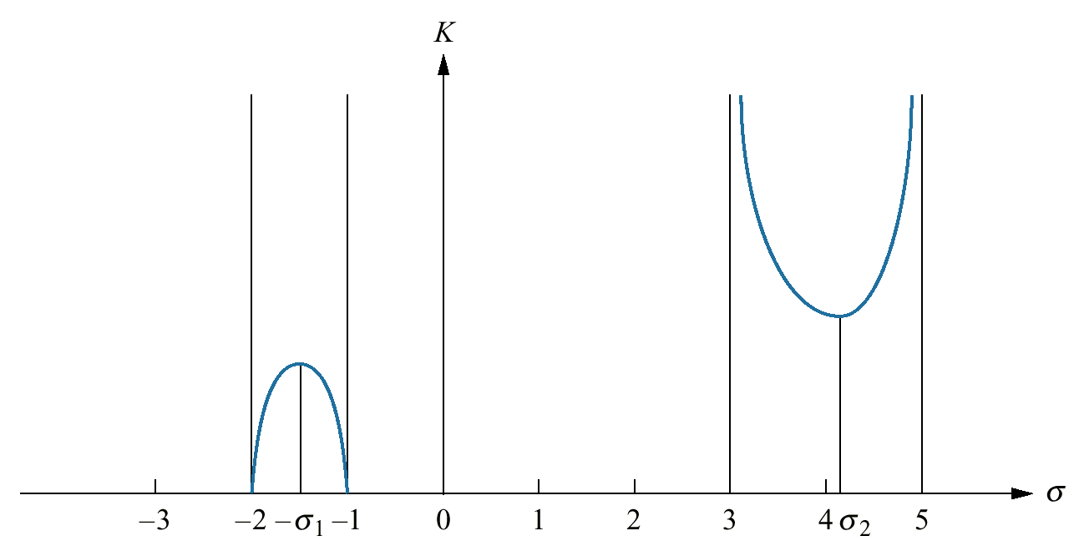
Breakaway and Break-in points:
Variation of gain along the real axis of the root locus
The breakaway point occurs at a point of maximum gain on the real axis between the open-loop poles
The gain at the break-in point is the minimum along the real axis between the two zeros

Slide 8

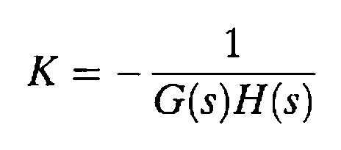
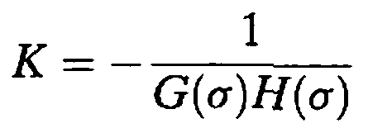
Considering the values of s on the real axis only ( i.e. s = σ )
How do we find maximum and minimum
???

Slide 9
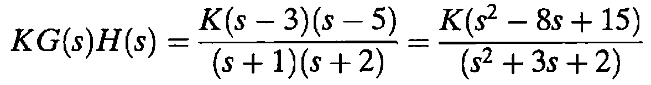
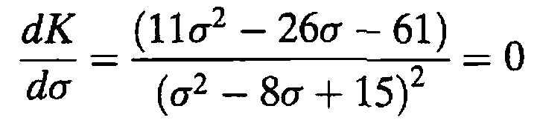
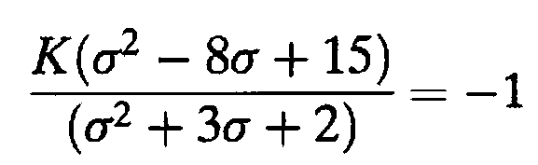
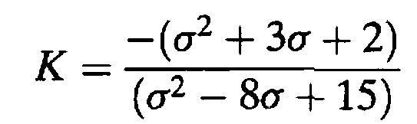
Example 8.3
Breakaway and Break-in Points via Differentiation
PROBLEM: Find the breakaway and break-in points for the root locus depicted in the Figure, using differential calculus.
SOLUTION:
Using the open-loop poles and zeros, the open-loop system is represented as:
For all points along the root locus, KG(s)H(s) = -1, and along the real axis, s = σ.
therefore
σ= -1.45, 3.8

Slide 10
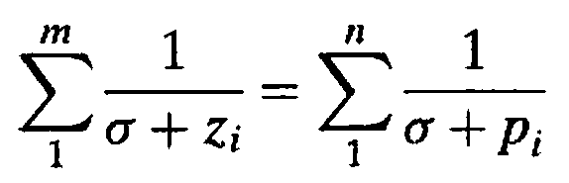
transition method
Breakaway and break-in points satisfy the relationship
where z_{i} and p_{i} are the negative of the zero and pole values, respectively, of G(s)H(s)

Slide 11
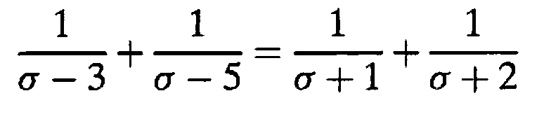
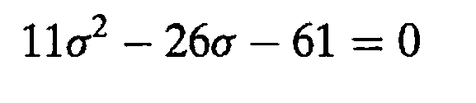

Example 8.3
Breakaway and Break-in Points via Differentiation
PROBLEM: Find the breakaway and break-in points for the root locus depicted in the Figure, using differential calculus.

Slide 12
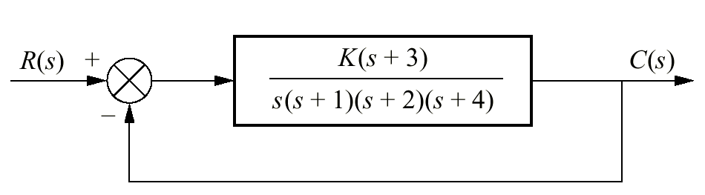
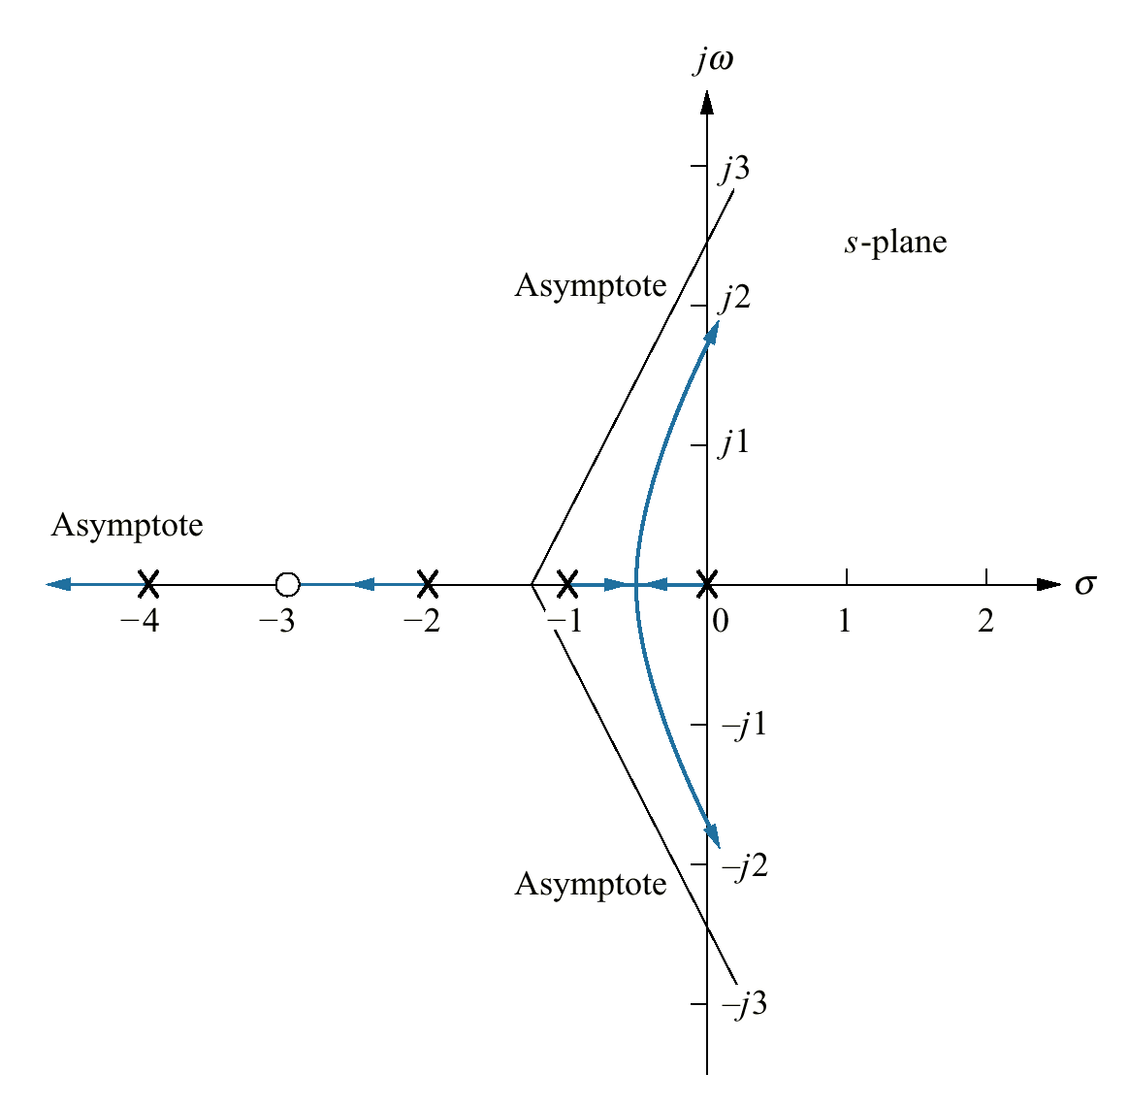
jω-axis Crossing
The jω-axis crossing separates the stable operation of the system from the unstable operation
The system's poles are in the left half-plane up to certain value of gain
Using Routh-Hurwitz criterion to find jω-axis crossing points

Slide 13


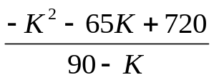
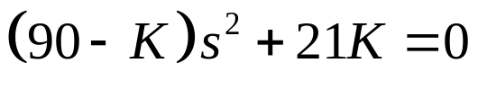



Example 8.5
For the system shown in the Figure, find the frequency and gain, K, for which the root locus crosses the imaginary axis. For what range of K is the system stable?
SOLUTION:
The closed-loop transfer function
s⁴
s³
s²
s¹
s⁰
1 | 14 | 3k
7 | 8+K | 0
{row s¹ zeros
K = 9.65, -74.65
90 - K | 21K | 0
 | 0 | 0
21K | 0 | 0
The RL is plotted only for +ve values of gain, thus K = 9.65
{aux polynomial
Range of stability of K
Jω-axis xing

Slide 14
j1.6
K=9.65
-j1.6
K=9.65

Slide 15
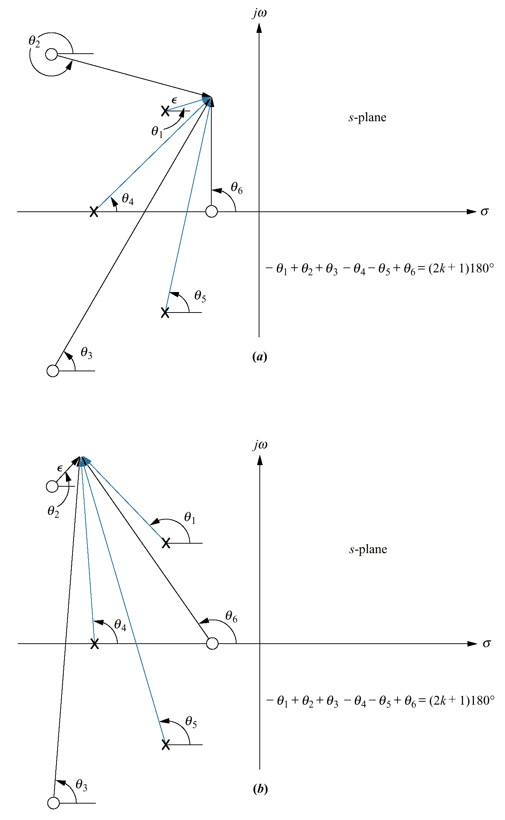
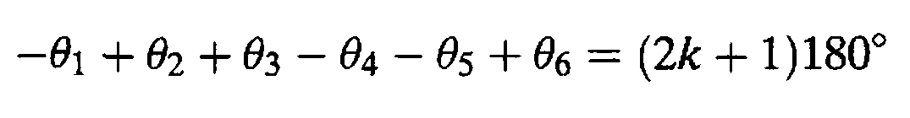
Angles of Departure and Arrival
Assume a point on the root locus ε close to a complex pole, the sum of angles drawn from all finite poles and zeros to this point is an odd multiple of 180°.
Except for the pole that is ε close to the point, assume vectors from all other poles and zeros are drawn directly to the pole that is near the point.
The only unknown angle is the angle θ₁ drawn from the pole close to the point.

Slide 16
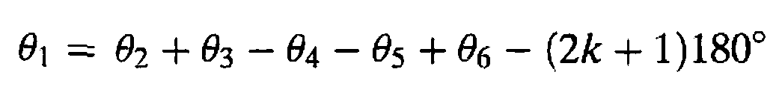
angle of departure

Slide 17
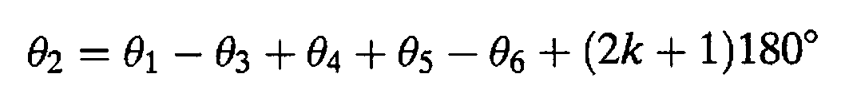
angle of arrival

Slide 18
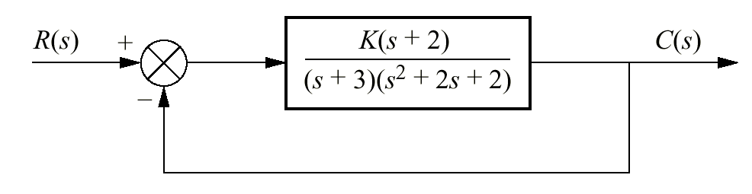
Example 8.6
Angle of Departure from a Complex Pole
PROBLEM: Given the unity feedback system shown in the Figure, find the angle of departure from the complex poles and sketch the root locus.

Slide 19
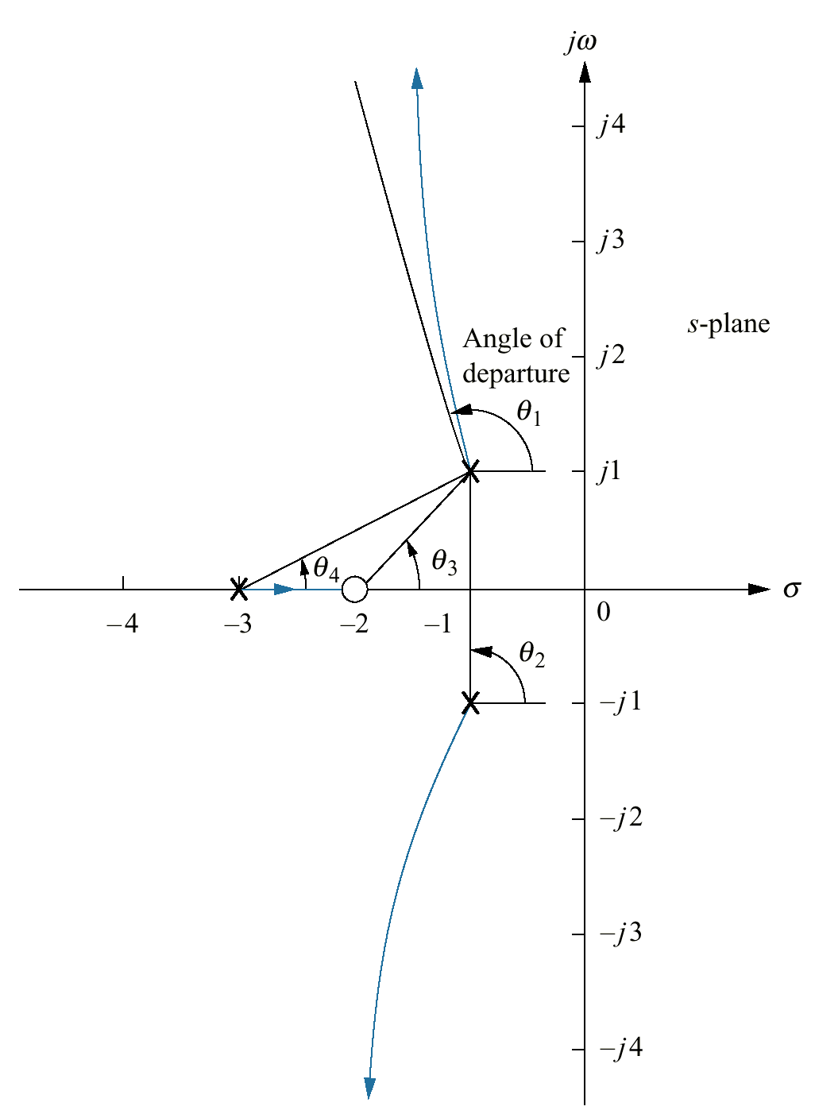
SOLUTION:
Using the poles and zeros of the transfer function, we calculate the sum of angles drawn to a point ε close to the complex pole, - 1 +j1, in the second quadrant.
or θ₁= -251.6° = 108.4

Slide 20
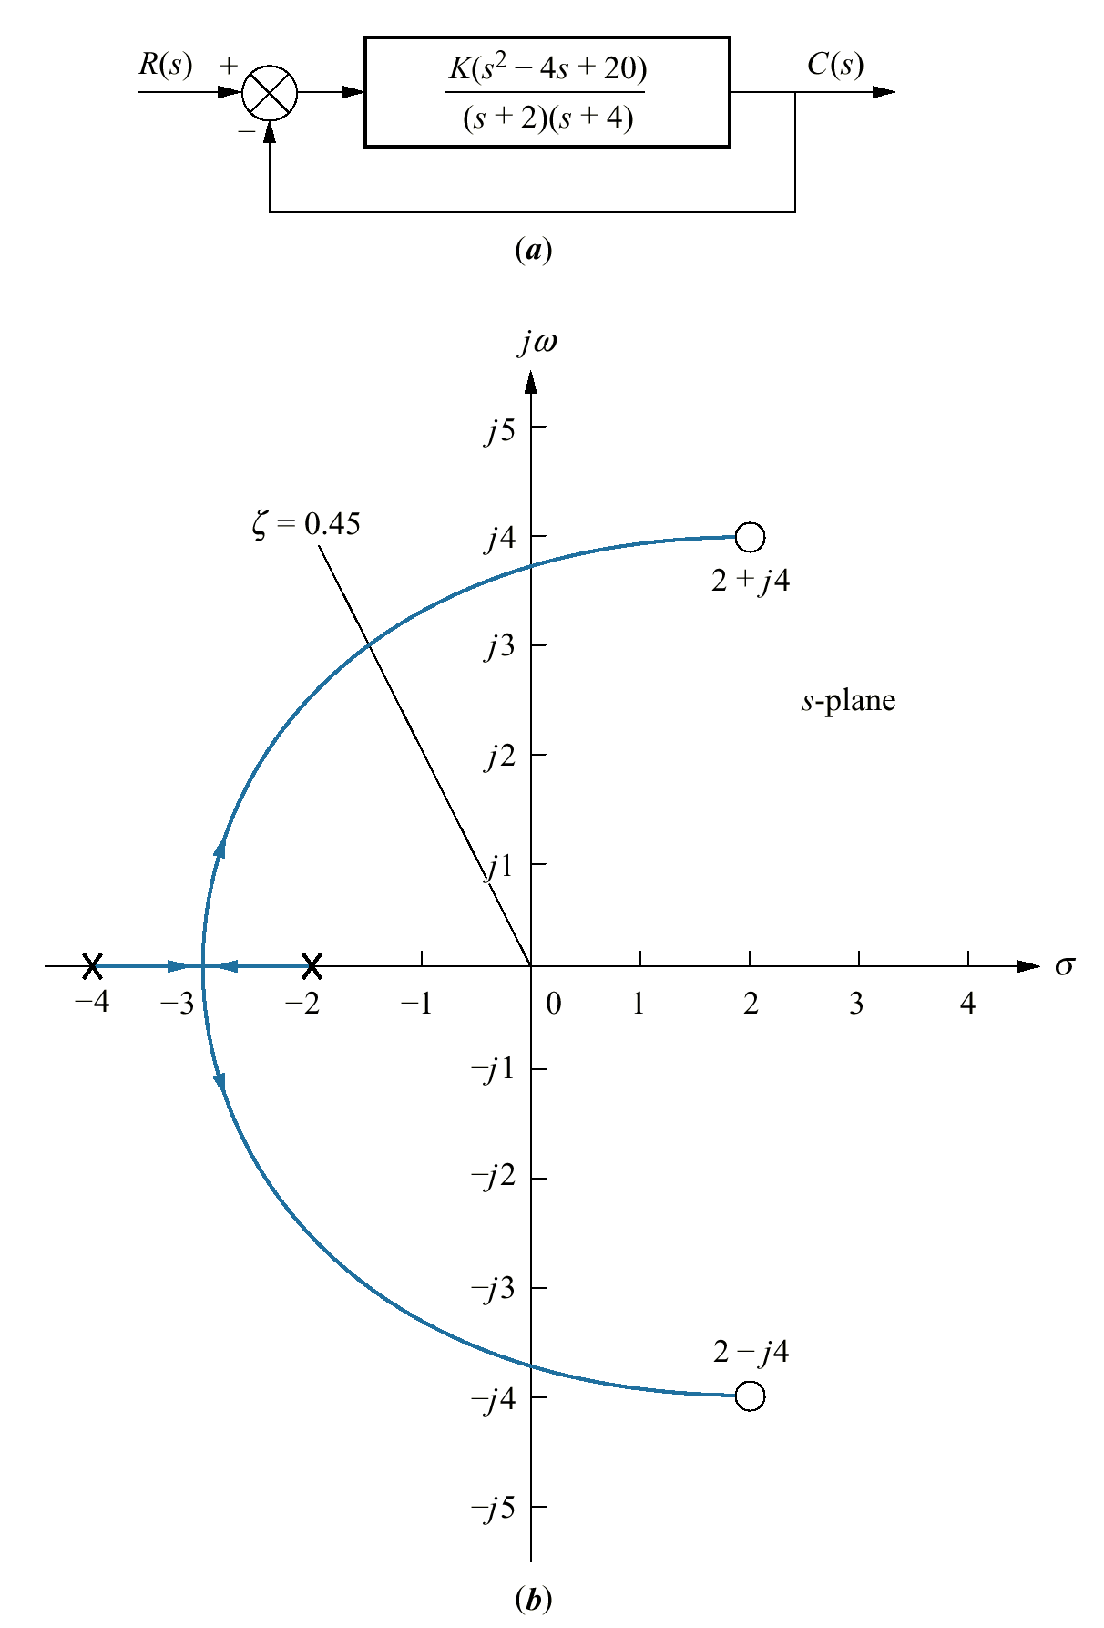
Example 8.7
Sketching a Root Locus and Finding Critical Points
PROBLEM: Sketch the root locus for the system shown in the Figure and find the following:
a. The exact point and gain where the locus crosses the 0.45 damping ratio line
b. The exact point and gain where the locus crosses the jω-axis
c. The breakaway point on the real axis
d. The range of K within which the system is stable

Slide 21

SOLUTION: Sketch the root locus.
The real-axis segment is between - 2 and -4.
The root locus starts at the open-loop poles and ends at the open-loop zeros.
a. Find the exact point where the locus crosses the ζ= 0.45 line
search along the line
for the point where the angles add up to an odd multiple of 180°
Try to develop algorithm

Slide 22
b. Find the exact point where the locus crosses the jω-axis
search along the line
θ = 90º
for the point where the angles add up to an odd multiple of 180°
The root locus crosses the jω-axis at ±j3.9 with a gain of K = 1.5
c. The breakaway point is between the open-loop poles on the real axis at -2.88
d. The system is stable for K between 0 and 1.5.

Slide 23
Transient Response Design via Gain Adjustment
Assignment
Read and understand the contents.

Slide 24
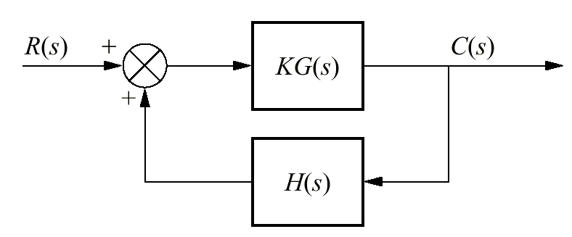

Definition
The closed-loop poles of the feedback control system:
-
are the roots of the characteristic equations:
The root locus is the path of the poles traced out in the s-plane as a system parameter varies from zero to infinity

Slide 25
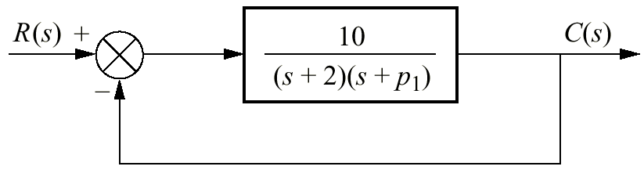
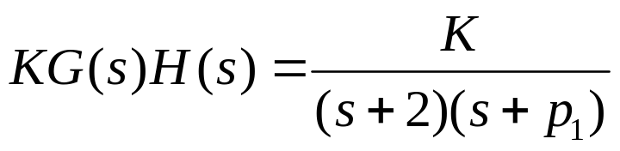
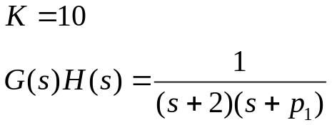
Root Locus for Variations of Parameters other than K
How can we obtain the root locus for variation of p₁
????

Slide 26
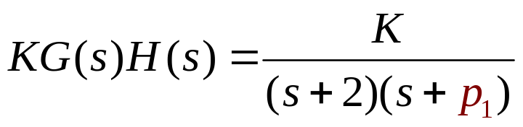
Problem
Parameter p₁ is not a multiplying factor of the function
Solution
Create an equivalent system where p₁ appears as the forward-path gain

Slide 27
The denominator of closed-loop transfer function's is:
1 + KG(s)H(s)
-
We want to create an equivalent system whose denominator is:
1 + p₁G(s)H(s)

Slide 28
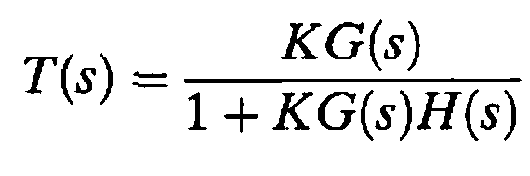
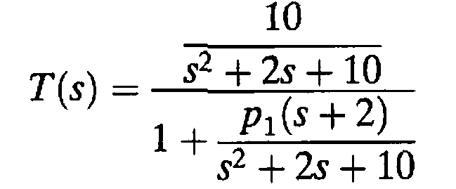
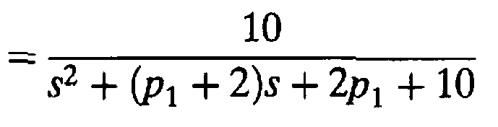
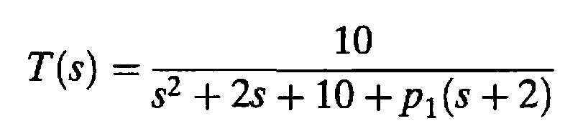
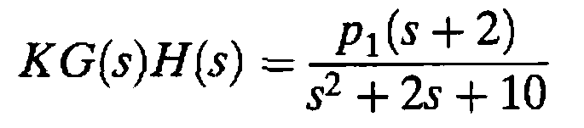

Slide 29
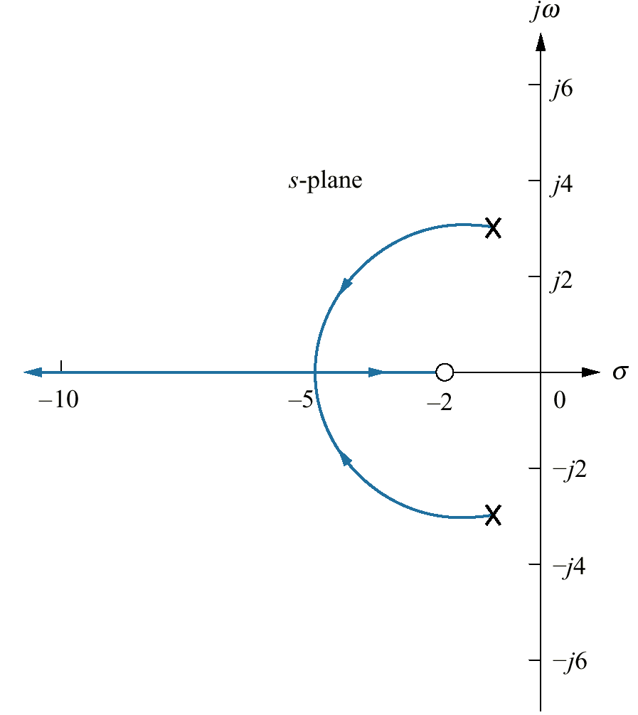
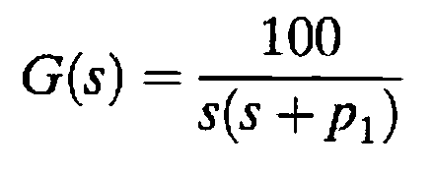
Assignment
Exercise 8.7
PROBLEM: Sketch the root locus for variations in the value of p₁ for a unity feedback system that has the following forward transfer function:

Slide 30
Root Locus for Positive-Feedback
Systems

Slide 31
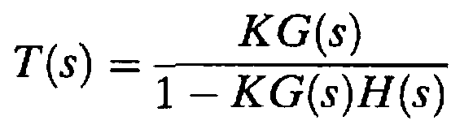


A positive-feedback system can be thought of as a negative-feedback system with a negative value of H(s)
The transfer function for the positive-feedback System is:

Slide 32
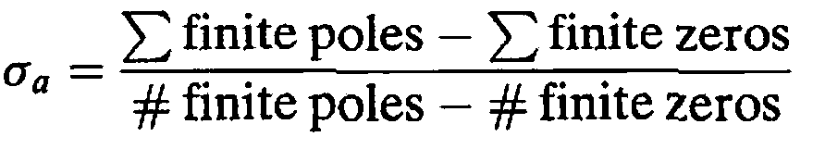
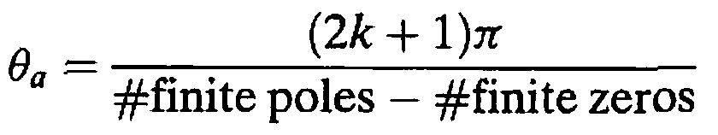
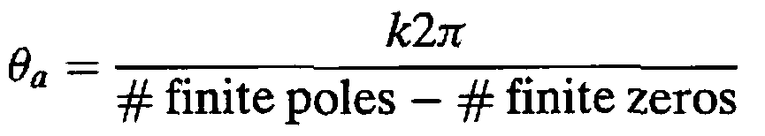
Real-axis segments:
On the real axis, the root locus for positive-feedback systems exists to the left of an even number of finite open-loop poles and/or finite open-loop zeros.
the real-axis intercept
For negative feedback system
Angle with the real axis

Slide 33
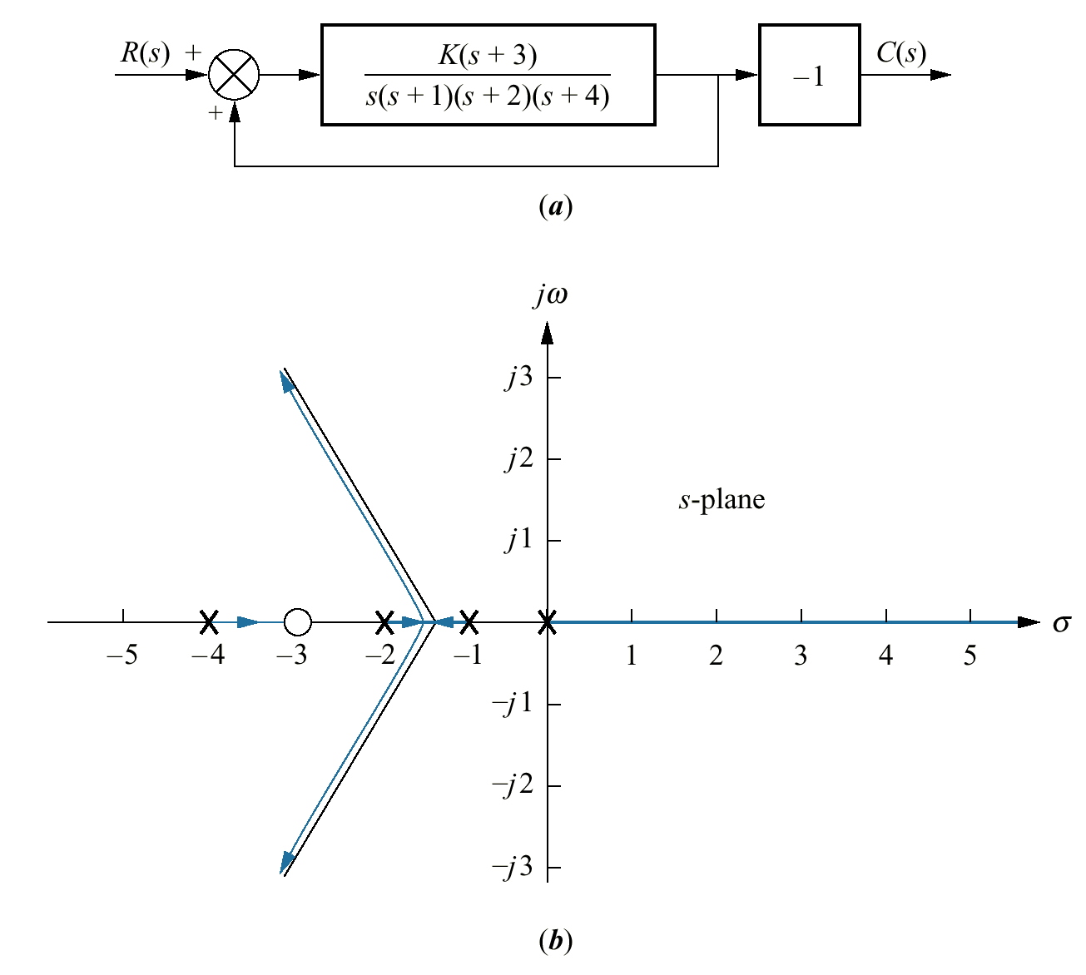
Example 8.9
Root Locus for a Positive-Feedback System
PROBLEM: Sketch the root locus as a function of negative gain, K, for the system shown in the Figure.
_
SOLUTION: The equivalent positive-feedback system found by pushing -1, associated with K, to the right past the pickoff point is:

Slide 34
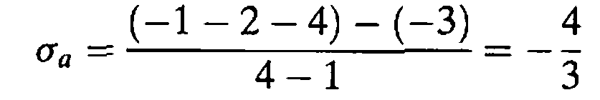
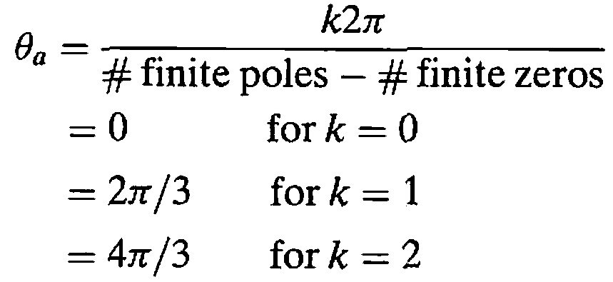

Slide 35

???

